Slide 1

DATA STRUCTURE WEEK 14
Contact Details:
Email: sobia.iftikhar@nu.edu.pk
GCR:

Slide 2
Content
Heap
Array Representation of BT
Complete Binary Tree
Heap
Insert & Delete
Heap Sort
Heapify
Priority Queue

Slide 3
Priority Queue Implementation
Arrays
Linked list
Heap data structure
Binary search tree

Slide 4
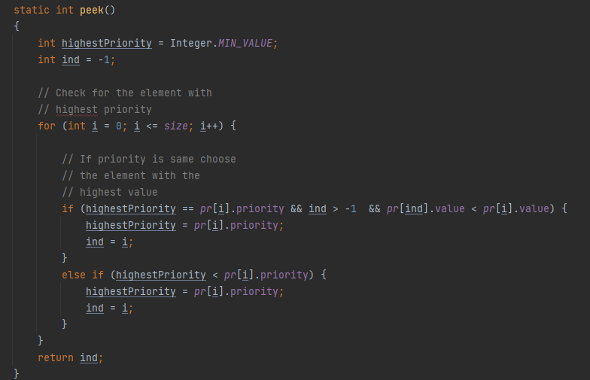
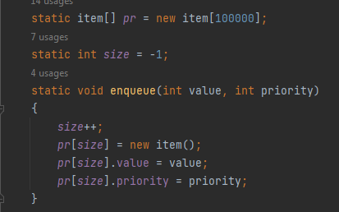
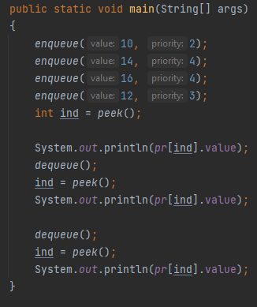
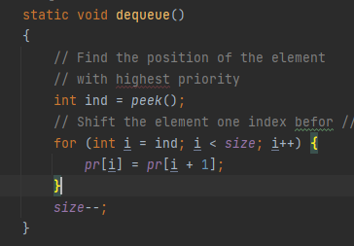
PQ-using Array
16
14
12

Slide 5
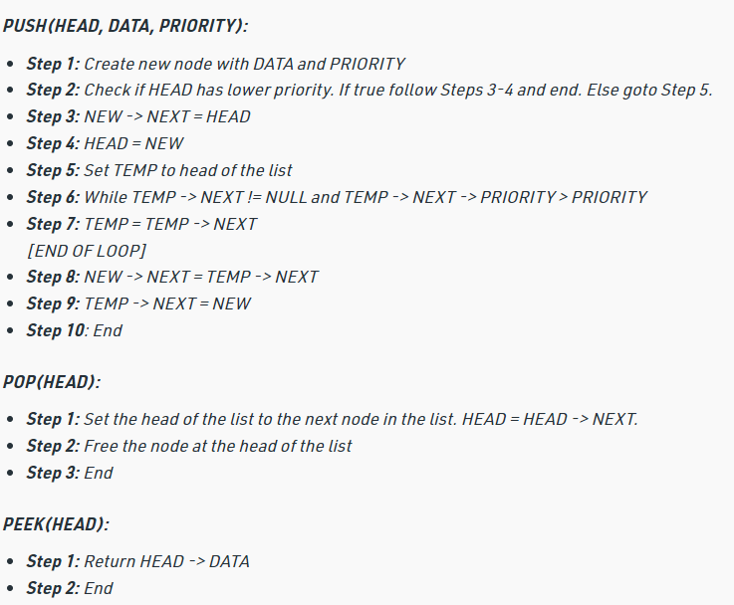
PQ using Linked List

Slide 6
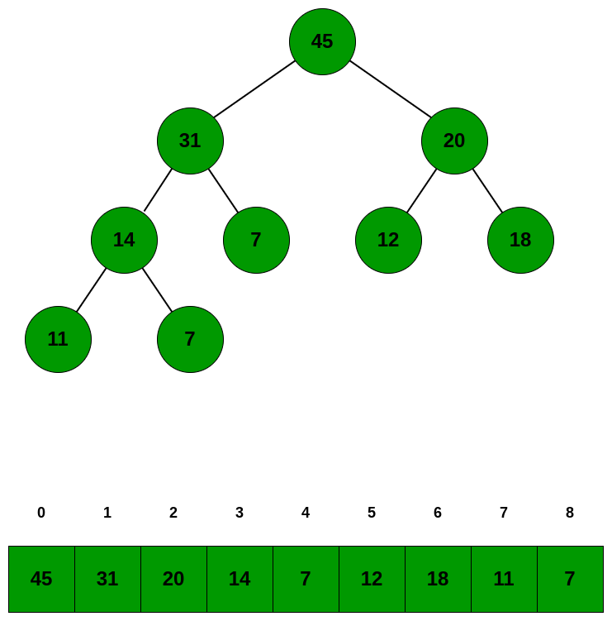
Pq using Heap
static int extractMax()
{
int result = H[0];
H[0] = H[size];
size = size - 1;
shiftDown(0);
return result;
}
static int []H = new int[50];
static int size = -1;
static int parent(int i)
{return (i - 1) / 2;}
static int leftChild(int i)
{ return ((2 * i) + 1); }
static int rightChild(int i)
{ return ((2 * i) + 2); }
static void changePriority(int i, int p)
{ int oldp = H[i];
H[i] = p;
if (p > oldp)
{shiftUp(i);}
else
{ shiftDown(i); }
}
static void insert(int p)
{
size = size + 1;
H[size] = p;
shiftUp(size);
}
Priority Queue : 45 31 14 13 20 7 11 12 7
Node with maximum priority : 45
Priority queue after extracting maximum : 31 20 14 13 7 7 11 12
Priority queue after priority change : 49 20 31 13 7 7 11 12
Priority queue after removing the element : 49 20 31 12 7 7 11

Slide 7
Hashing
Hashing is a technique or process of mapping keys, and values into the hash table by using a hash function. It is done for faster access to elements.
It is the method for storing and retrieving the data from database in order of one time (constant time)
Larger value in to smaller value by using hasing. Some time called mapping.

Slide 8
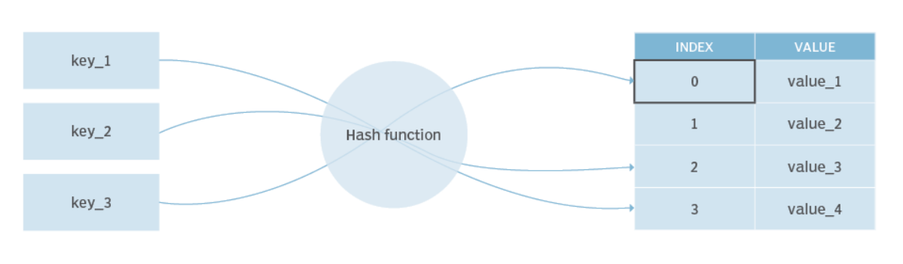
Hash Function
A Hash Function is a function that converts a given numeric or alphanumeric key to a small practical integer value. The mapped integer value is used as an index in the hash table. In simple terms, a hash function maps a significant number or string to a small integer that can be used as the index in the hash table.
Division Method.
Mid Square Method.
Folding Method..

Slide 9
Hash Function-1. Division Method:
Hash Table k mod 10
h(K) = k mod M
Here, k is the key value, and M is the size of the hash table.
 | 0
91 | 1
52 | 2
83 | 3
24 | 4
 | 5
 | 6
67 | 7
48 | 8
 | 9
Sear Key (24, 52,91,67,48,83)
Hash Table

Slide 10
Hash Function
Hash Function (k mod 10 , k mod n, Mid Square, Folding Method)
K mod 10: -> 24 mod 10 = 4 (place 24 at index 4. (4) is has value)
K mod n: => n always given to you.
Mid square: example= 123 = mid value 2^2 =4
Folding Method: Example = 123456 (hash table is 0 – 999, how to store such huge number) => 123

Slide 11
Hash Function= Example
Hash Table k mod 10
 | 0
91 | 1
52 | 2
83 | 3
24 | 4
 | 5
 | 6
67 | 7
48 | 8
 | 9
Search(67)
Use has function 67 mod 10 = 7 go to 7 index
Other operation also performed by one time

Slide 12
Hash Function
Determines position of key in the array.
Assume table (array) size is N
Function f(x) maps any key x to an int between 0 and N−1
For example, assume that N=15, that key x is a non-negative integer between 0 and MAX_INT, and hash function f(x) = x % 15.
(Hash functions for strings aggregate the character values --- see Weiss §5.2.)

Slide 13
Hash Function
Let f(x) = x % 15. Then,
if x = 25 129 35 2501 47 36
f(x) = 10 9 5 11 2 6
Storing the keys in the array is straightforward:
0 1 2 3 4 5 6 7 8 9 10 11 12 13 14
_ _ 47 _ _ 35 36 _ _ 129 25 2501 _ _ _
Thus, delete and find can be done in O(1), and also insert, except…

Slide 14
Hash Tab using Array
void init()
{
int i;
for(i = 0; i < size; i++)
arr[i] = -1;
}
void insert(int value)
{
int key = value % size;
if(arr[key] == -1)
{
arr[key] = value;
printf("%d inserted at arr[%d]\n", value,key);
}
else
{
printf("Collision : arr[%d] has element %d already!\n",key,arr[key]);
printf("Unable to insert %d\n",value);
}
}
void del(int value)
{
int key = value % size;
if(arr[key] == value)
arr[key] = -1;
else
printf("%d not present in the hash table\n",value);
}

Slide 15
Hash Function
What happens when you try to insert: x = 65 ?
x = 65
f(x) = 5
0 1 2 3 4 5 6 7 8 9 10 11 12 13 14
_ _ 47 _ _ 35 36 _ _ 129 25 2501 _ _ _
65(?)
This is called a collision.

Slide 16
Handling Collisions
Separate Chaining
Open Addressing
Linear Probing
Quadratic Probing
Double Hashing

Slide 17
Handling Collisions
Separate Chaining

Slide 18
Separate Chaining/ Open Hashing
Let each array element be the head of a chain.
0 1 2 3 4 5 6 7 8 9 10 11 12 13 14
↓ ↓ ↓ ↓ ↓ ↓
47 65 36 129 25 2501
↓
35
Where would you store: 29, 16, 14, 99, 127 ?

Slide 19
Separate Chaining
Let each array element be the head of a chain:
Where would you store: 29, 16, 14, 99, 127 ?
0 1 2 3 4 5 6 7 8 9 10 11 12 13 14
↓ ↓ ↓ ↓ ↓ ↓ ↓ ↓ ↓
16 47 65 36 127 99 25 2501 14
↓ ↓ ↓
35 129 29
New keys go at the front of the relevant chain.

Slide 20
Open Hasing (Chaining)
10 | 0
 | 1
2000 | 2
 | 3
19 | 4
Keys (42, 19, 10, 12)
K mod 5
Advantages:
Deletion is easy
Disadvantages:
Parts of the array might never be used.
As chains get longer, search time increases to O(n) in the worst case.
Constructing new chain nodes is relatively expensive (still constant time, but the constant is high).
Is there a way to use the “unused” space in the array instead of using chains to make more space?
12 | 1000
42 | 1000
1000
2000

Slide 21
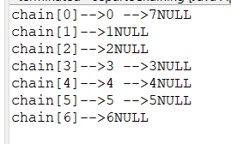
Hash Table Using Separate Chaining
class HashTablesExample {
class LinkedHash {
String key;
int value;
LinkedHash next;
LinkedHash(String key, int value)
{
this.key = key;
this.value = value;
this.next = null;
}
}
size = 0;
tableSize = ts;
table = new LinkedHash[tableSize];
for (int i = 0; i < tableSize; i++)
table[i] = null;
node newNode = new node(value);
int key = value % size;
if(chain[key] == null) {
chain[key] = newNode;
tail = newNode;
}
else {
//Node temp will point to head
node temp = head;
//newNode will become new head of the list
head = newNode;
//Node temp(previous head) will be added after new head
head.next = temp;
}

Slide 22
Handling Collisions
Linear Probing

Slide 23
Close hashing(Linear probing)
19 | 0
 | 1
72 | 2
43 | 3
23 | 4
135 | 5
82 | 6
 | 7
 | 8
99 | 9
Keys (43, 135, 72, 23,99,19,82)
H(k)= K mod 10
H(k,i) = (h(k)+i) mod 10
Advantages:
No Extra Space
Disadvantages:
Search time o(n)
Deletion Difficult
Primary Clustering
Secondary clustering
Collision occur (23)
- h(k) 23 mod 10 = 3
(3 +I )mod 10 = 4
: i = 1 is attempt (prob)
19- array is complete reverse beck
82 mod 10 = 2
(2 + 1) = 3 filled
(2 + 2) = 4 filled
(2 + 3) = 5 filed
(2+ 4) = 6 we can [place here

Slide 24
Close hashing(Linear probing)
19 | 0
 | 1
72 | 2
43 | 3
23 | 4
135 | 5
82 | 6
 | 7
 | 8
99 | 9
Keys (43, 135, 72, 23,99,19,82)
H(k)= K mod 10
H(k,i) = (h(k)+i) mod 10
Advantages:
No Extra Space
Disadvantages:
Search time o(n)
Deletion Difficult
Primary Clustering
Secondary clustering
Best and average case for search time in o(1) but for worst time is o(n)
example 112 also need to place on index 2 but due to already filled we will place on 7th index for the search time will increase by n time.
For deletion: lets suppose you are searching for 82 and before searching 82 we deleted 43 from index 3 at that time your search operation will stop at index 3 because it is empty.

Slide 25
Linear Probing
Let key x be stored in element f(x)=t of the array
0 1 2 3 4 5 6 7 8 9 10 11 12 13 14
47 35 36 129 25 2501
65(?)
What do you do in case of a collision?
If the hash table is not full, attempt to store key in the next array element (in this case (t+1)%N, (t+2)%N, (t+3)%N …)
until you find an empty slot.

Slide 26
Linear Probing
Where do you store 65 ?
0 1 2 3 4 5 6 7 8 9 10 11 12 13 14
47 35 36 65 129 25 2501
↑ ↑ ↑
attempts
Where would you store: 29?

Slide 27
Linear Probing
If the hash table is not full, attempt to store key in array elements (t+1)%N, (t+2)%N, …
0 1 2 3 4 5 6 7 8 9 10 11 12 13 14
47 35 36 65 129 25 2501 29
↑
attempts
Where would you store: 16?

Slide 28
Linear Probing
If the hash table is not full, attempt to store key in array elements (t+1)%N, (t+2)%N, …
0 1 2 3 4 5 6 7 8 9 10 11 12 13 14
16 47 35 36 65 129 25 2501 29
↑
Where would you store: 14?

Slide 29
Linear Probing
If the hash table is not full, attempt to store key in array elements (t+1)%N, (t+2)%N, …
0 1 2 3 4 5 6 7 8 9 10 11 12 13 14
14 16 47 35 36 65 129 25 2501 29
↑ ↑
attempts
Where would you store: 99?

Slide 30
Linear Probing
If the hash table is not full, attempt to store key in array elements (t+1)%N, (t+2)%N, …
0 1 2 3 4 5 6 7 8 9 10 11 12 13 14
14 16 47 35 36 65 129 25 2501 99 29
↑ ↑ ↑ ↑
attempts
Where would you store: 127 ?

Slide 31
Linear Probing
If the hash table is not full, attempt to store key in array elements (t+1)%N, (t+2)%N, …
0 1 2 3 4 5 6 7 8 9 10 11 12 13 14
16 47 35 36 65 127 129 25 2501 29 99 14
↑ ↑
attempts

Slide 32
Linear Probing
Search efficiency problem remains.
Deletion becomes trickier….

Slide 33
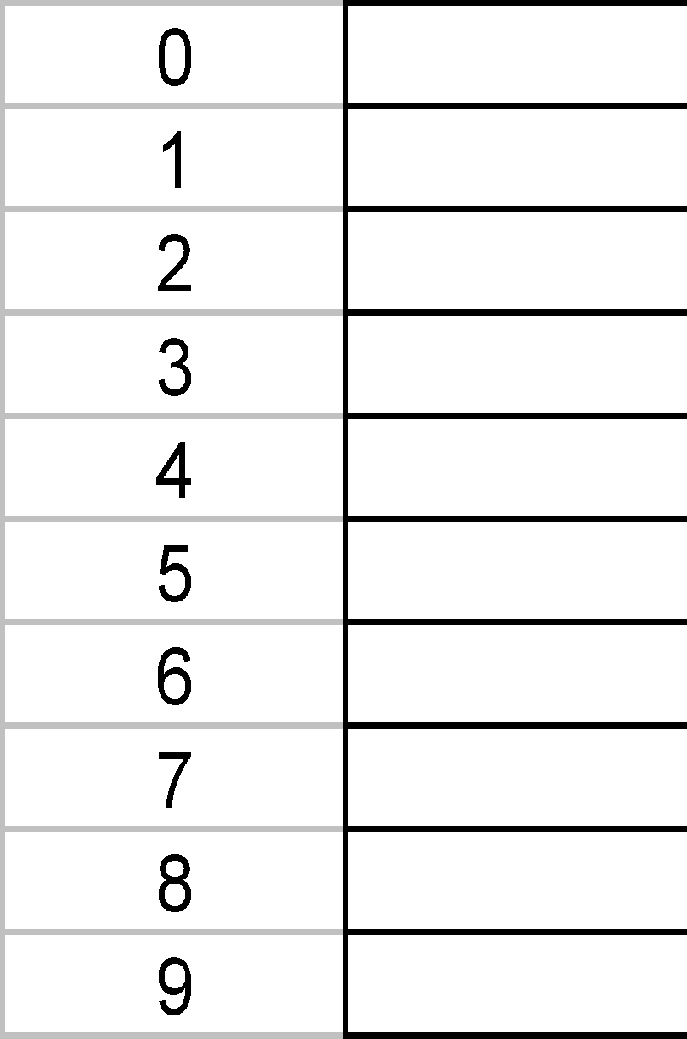
Deletion problem
H=KEY MOD 10
Insert 47, 57, 68, 18, 67
Find 68
Find 10
Delete 47
Find 57

Slide 34
Handling Collisions
Quadratic Probing

Slide 35
Close hashing(Quadratic probing)
36 | 0
91 | 1
42 | 2
33 | 3
 | 4
 | 5
16 | 6
27 | 7
18 | 8
 | 9
Keys (42, 16, 91, 33,18,27,36,62)
H(k)= K mod 10
H(k,i) = (h(k)+i^2) mod 10
Advantages:
No Extra Space
Disadvantages:
No guarantee of finding slot
For 36 collision: use has function
H(k) = 36 mod 10 = 6
(6 + 1^2) = 7 filled
(6 + 2^2) = 10 mod 10 = 0
62 ?
H(k) = 62 mod 10 = 2
(2 + 1^2) = 3 filled
(2 + 2^2) = 6 filled
(2 + 3^2 = 11 mod 10 = 1 filled
(2 + 4^2) = 18 mod 10 = 8 filled
(2 + 5^2) = 27 mod 10 = 7 filled
(2 + 6^2) = 38 mod 10 = 8 filled
(2 + 7^2) = 51 mod 10 = 1 filled
(2 + 8^2) = 66 mod 10 = 6 filled
(2 + 9^2) = 83 mod 10 = 3 filled
(2 +10^2) = 102 mod 10 = 2 filled
( 2+ 11^2) = 123 mod 10 = 3 filled
(2 + 12^2) =

Slide 36
Quadratic Probing
Let key x be stored in element f(x)=t of the array
0 1 2 3 4 5 6 7 8 9 10 11 12 13 14
47 35 36 129 25 2501
65(?)
What do you do in case of a collision?
If the hash table is not full, attempt to store key in array elements (t+1²)%N, (t+2²)%N, (t+3²)%N …
until you find an empty slot.

Slide 37
Quadratic Probing
Where do you store 65 ? f(65)=t=5
0 1 2 3 4 5 6 7 8 9 10 11 12 13 14
47 35 36 129 25 2501 65
↑ ↑ ↑ ↑
t t+1 t+4 t+9
attempts
Where would you store: 29?

Slide 38
Quadratic Probing
If the hash table is not full, attempt to store key in array elements (t+1²)%N, (t+2²)%N …
0 1 2 3 4 5 6 7 8 9 10 11 12 13 14
29 47 35 36 129 25 2501 65
↑ ↑
t+1 t
attempts
Where would you store: 16?

Slide 39
Quadratic Probing
If the hash table is not full, attempt to store key in array elements (t+1²)%N, (t+2²)%N …
0 1 2 3 4 5 6 7 8 9 10 11 12 13 14
29 16 47 35 36 129 25 2501 65
↑
t
attempts
Where would you store: 14?

Slide 40
Quadratic Probing
If the hash table is not full, attempt to store key in array elements (t+1²)%N, (t+2²)%N …
0 1 2 3 4 5 6 7 8 9 10 11 12 13 14
29 16 47 14 35 36 129 25 2501 65
↑ ↑ ↑
t+1 t+4 t
attempts
Where would you store: 99?

Slide 41
Quadratic Probing
If the hash table is not full, attempt to store key in array elements (t+1²)%N, (t+2²)%N …
0 1 2 3 4 5 6 7 8 9 10 11 12 13 14
29 16 47 14 35 36 129 25 2501 99 65
↑ ↑ ↑
t t+1 t+4
attempts
Where would you store: 127 ?

Slide 42
Quadratic Probing
If the hash table is not full, attempt to store key in array elements (t+1²)%N, (t+2²)%N …
Where would you store: 127 ?
0 1 2 3 4 5 6 7 8 9 10 11 12 13 14
29 16 47 14 35 36 127 129 25 2501 99 65
↑
t
attempts

Slide 43
Quadratic Probing
Tends to distribute keys better than linear probing
Alleviates problem of clustering
Runs the risk of an infinite loop on insertion, unless precautions are taken.
E.g., consider inserting the key 16 into a table of size 16, with positions 0, 1, 4 and 9 already occupied.
Therefore, table size should be prime.

Slide 44
Example
20 | 0
1 | 1
8 [ 9 prob] | 2
 | 3
12 | 4
25 | 5
4 | 6
6 | 7
18 | 8
3 | 9
The keys (1,3,12, 4, 25,6,18,20,8 ) are inserted into hash table of
Length 10 with hash function h(k) = i^2 mod 10 and linear probing
What is the resultant hash table, Find the maximum prob value.
H(k) = i^2 mod 10

Slide 45
Handling Collisions
Double Hashing

Slide 46
Double Hashing
Collision 45:
(h1(k) + i h2(k)) mod 11
( 1 + i.3) mod 11 :- I =1 fist Collison
4 mod 11 = 4
:- h2(k) = 8 – (45 mod 8)
:- h2(k) = 8 – (5) = 3
Collison 70
(h1(k) + i h2(k)) mod 11
( 4 + i.2) mod 11 :- I =1 fist Collison
6 mod 11 = 6
Collison 56
(h1(k) + i h2(k)) mod 11
-( 1 + i.8) mod 11 :- I =1 fist Collison
9 mod 11 = 9 filled
-( 1 + 2.8) mod 11 :- I =2 2nd Collison
17 mod 11 = 6 filled
-( 1 + 3.8) mod 11 :- I =3 3rd Collison
25 mod 11 = 3
 | 0
34 | 1
 | 2
56 | 3
45 | 4
 | 5
70 | 6
 | 7
 | 8
20 | 9
 | 10
H1(k) = k mod 11
H2(k) = 8 – (k mod 8)
(h1(k) + h2(k)) mod 11
Keys: 20 , 34, 45, 70,56
Pros:
Cons:

Slide 47
Thank you

